Slide 1

Mecanum Robot
Kevin Moen Storvik
Ruben Aakervik
Peter Osnes

Slide 2
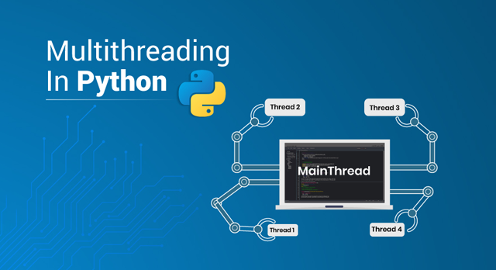
Threading and multithreading in Python vs Java
Python Threading compared to Java
GIL – Global Interpreter Lock
Multiprocessing vs Multithreading

Slide 3
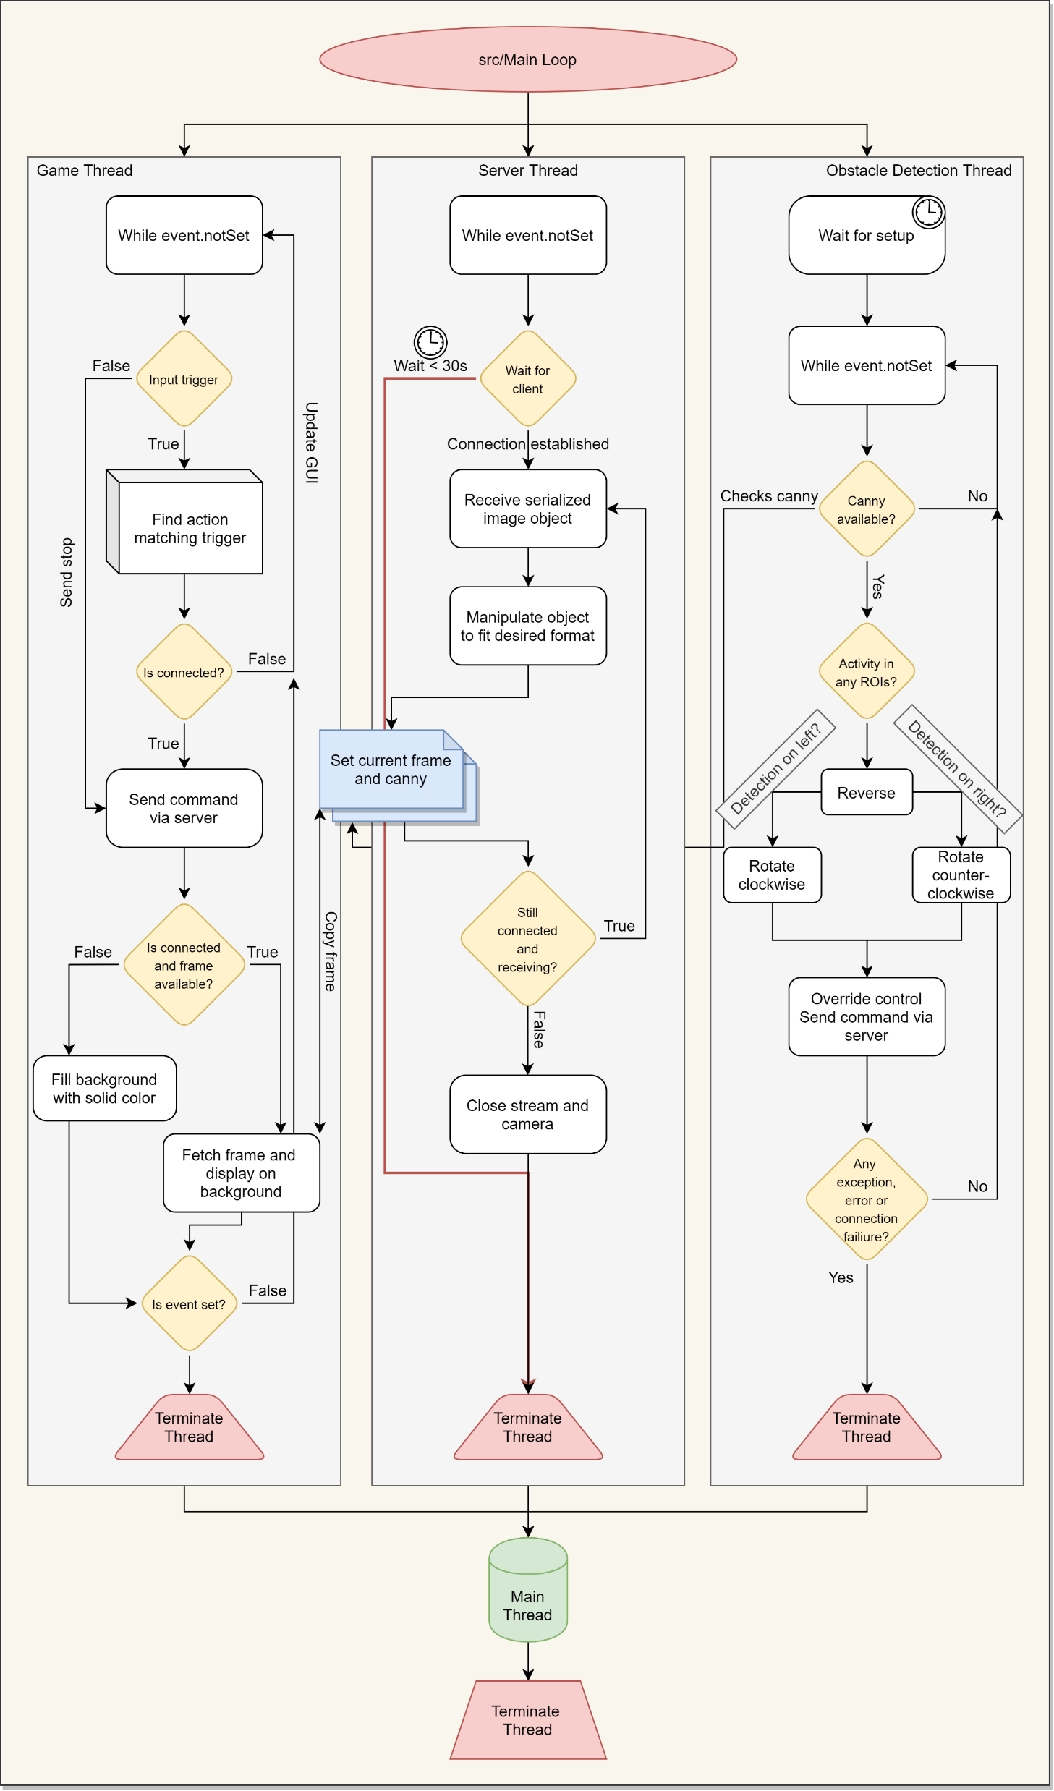
Fullmainloop

Slide 4
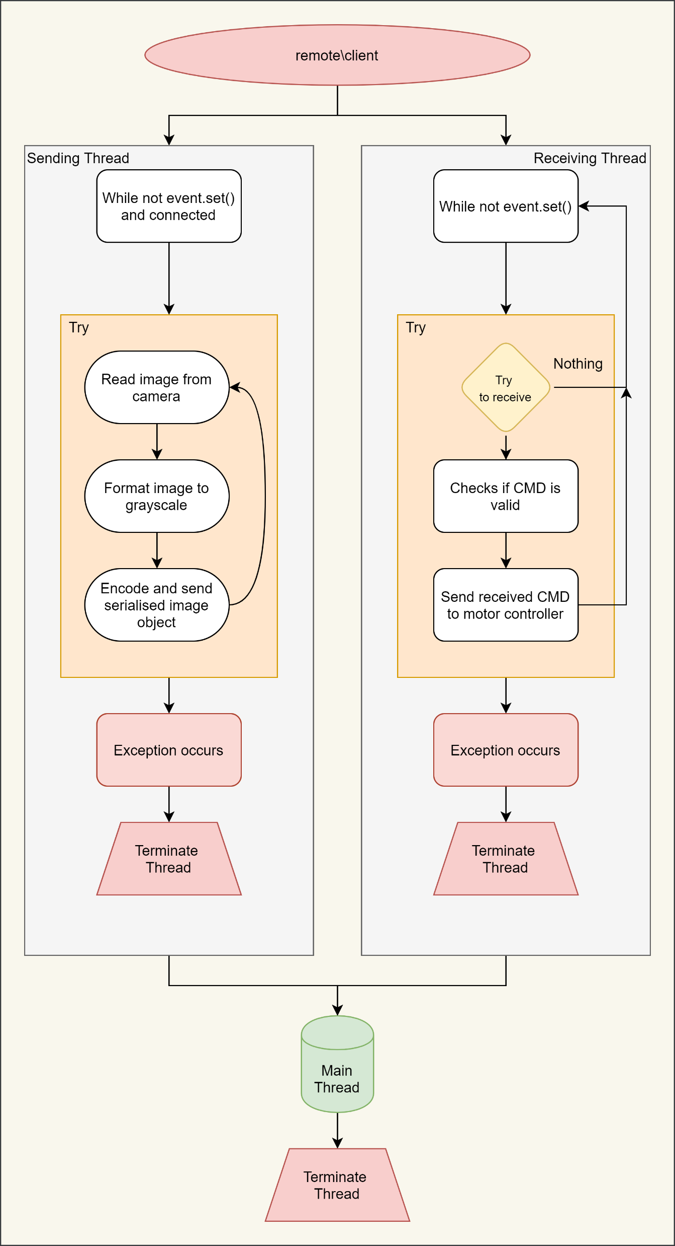
Remoteloop

Slide 5
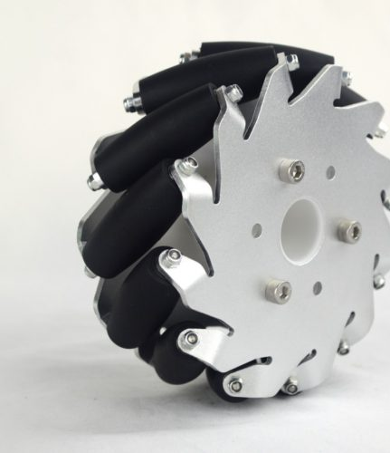
Mecanum Wheels
Omnidirectional movement
Friction
It’s cool

Slide 6
Improvements
Automative movement with both CannyEdge detection and Object Detection
Vector based controll
Better hardware, like wheels, platform etc.

